Slide 1
Outline of Today’s Discussion
Introduction to Non-Linear Regression
Statistical Significance: Decision Errors
Statistical Significance: Effect Size
Statistical Significance: Statistical Power
Some Intuitions about Power & Sample Size
Using Power To Estimate Sample Size

Slide 2
The Research Cycle
Real
World
Research
Representation
Abstraction
Generalization
Methodology
***
Research
Conclusions
Data Analysis
Research
Results

Slide 3
Part 1
Introduction To
Non-linear Regression

Slide 4
Intro to Non-Linear Regression
So, far our regression (prediction) has been linear.
Graphically, we’ve attempted to describe our data with a straight line on a scatter plot.
Computationally, we’ve used the linear equation:
y = mx + b
Remember that any mathematical function can be expressed by an equation AND by a picture.
Sometimes the relationship between the predictor and the criterion is orderly...BUT NOT LINEAR!

Slide 5
Intro to Non-Linear Regression
Polynomial Equations (i.e., “many names”) – requires estimating one coefficient for each “order”.
In this context, an “order” is an exponential power.
The linear equation is a first order polynomial. Why?
y = mx + b
The quadratic equation is a second order polynomial. Why?
y = ax² + bx + c
Here’s a third order polynomial. What would its graph look like?
y = ax³ + bx² + cx + d

Slide 6
Intro to Non-Linear Regression
We can compute a correlation coefficient for polynomials or any non-linear equation -just as we did for the simple linear equation.
As always, the correlation coefficient (r-statistic) indicates the strength and the direction of the relationship between variables. (The direction is specified by the sign of the highest order coefficient in the polynomial.)
As always, the coefficient of determination (r-squared) indicates the proportion of variability in the criterion that is ‘explained by’ (UGH!) the predictor.

Slide 7
Intro to Non-Linear Regression
Higher and higher order polynomials can ‘account for’ greater and greater proportions of variance (bigger r-squared values).
Potential Pop Quiz Question:
How does Ockham’s razor
relate to the use of
polynomials in (non-linear)
regression analysis?

Slide 8
Intro to Non-Linear Regression
Here are a few commonly used non-linear functions (i.e., equations or “models”) that differ from the standard polynomial format...
Power Function: y = b * (x^{m})
Logarithmic Function: y = m * Ln(x) + b
Exponential Function: y = b * (e^{m * x})
Slope is controlled by ‘m’, intercept is controlled by ‘b’.
What does the “Ln” mean? What does “e” mean?
Note: You do NOT need to memorize these formulas!!!

Slide 9
Intro to Non-Linear Regression
Great news! We can get the best-fitting non-linear graphs, and the equations, and the r-squared value just by pointing an clicking! Excel to the rescue!
Begin by creating a scatter plot in excel, as we’ve done before.
Select a function, and use the OPTIONS menu to add
-display equation on chart
-display r-squared value on chart

Slide 10
Part 2
Statistical Significance:
Decision Errors

Slide 11
Decision Errors
When the right procedure leads to the wrong conclusion
Type I Error
Reject the null hypothesis when it is true
Conclude that a manipulation had an effect when in fact it did not
Type II Error
Fail to reject the null when it is false
Conclude that a manipulation did not have an effect when in fact it did

Slide 12
Decision Errors
Setting a strict significance level (e.g., p < .001)
Decreases the possibility of committing a Type I error
Increases the possibility of committing a Type II error
Setting a lenient significance level (e.g., p < .10)
Increases the possibility of committing a Type I error
Decreases the possibility of committing a Type II error

Slide 13
Decision Errors

Slide 14
Part 3
Statistical Significance:
Effect Size

Slide 15
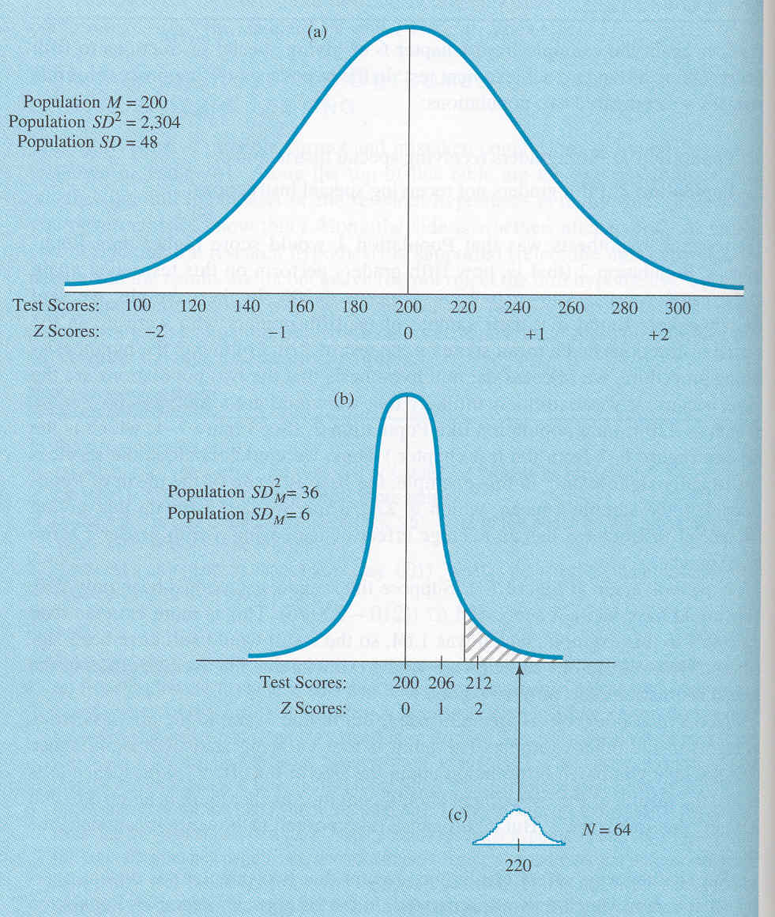
Effect Size
Potential Pop Quiz Question:
If picture “c” were to be
represented on an SPSS
output, what would be a
plausible “sig” value?
How about an implausible “sig”
value?
Explain your answer.

Slide 16
Effect Size
There is Trouble in Paradise
(Say it with me)

Slide 17
Effect Size
One major problem with Null Hypothesis Testing (i.e., inferential statistics) is that the outcome depends on sample size.
For example, a particular set of scores might generate a non-significant t-test with n=10. But if the exact same numbers were duplicated (n=20) the t-test suddenly becomes “significant”.
Demo on doubling the sample size

Slide 18
Effect Size
Effect Size – The magnitude of the influence that the IV has on the DV.
Effect size does NOT depend on sample size! (“And there was much rejoicing!”)

Slide 19
Effect Size
Note: APA recommends
reporting an effect size (e.g., Cohen’s d, or eta^2)
along with the inferential statistic (e.g. t, f, or r stat).
This way, we learn whether an effect is ‘reliable’
(that’s what the inferential statistic tells us)
and also how large the effect is.
(That’s what Cohen’s d and eta^2 tells us).

Slide 20
Effect Size
A statistically significant effect is said to be a ‘reliable effect’… it would be found repeatedly if the sample size were sufficient.
Statistically significant effects are NOT due simply to chance.
An effect can be statistically significant, yet ‘puny’.
There is an important distinction between statistical significance, and practical significance…

Slide 21
Effect Size
Examples that distinguish effect size and statistical significance….
Analogy to a Roulette Wheel – An effect can be small, but reliable.
Anecdote about the discovery of the planet Neptune -An effect can be small, but reliable.
Anecdote about buddy’s doctoral thesis, “Systematic non-linearities in the production of time intervals”.
Denison versus “Other” in S.A.T. scores.

Slide 22
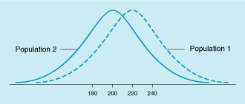
Effect Size
Amount that two populations do not overlap
The extent to which the experimental procedure had the effect of separating the two groups
Calculated by dividing the difference between the two population means by the population standard deviation
Effect size conventions
Small = .20
Medium = .50
Large = .80

Slide 23
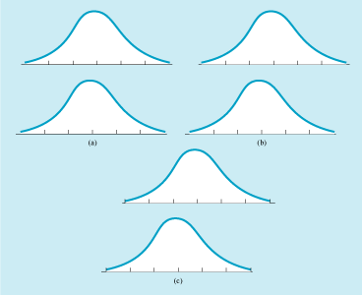
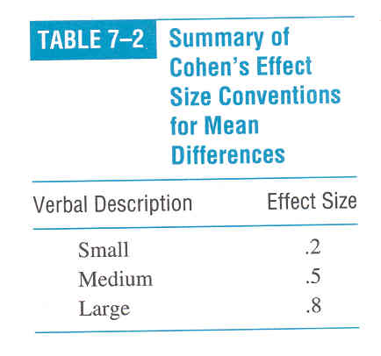
Effect Size Conventions
Pairs of population distributions showing
Small effect size
Medium effect size
Large effect size
Potential Pop Quiz Question:
How would you explain
the above graph to a 6th grader?

Slide 24
Effect Size & Meta-Analysis
Critical Thinking Question: In your own words, contrast a meta-analysis with a narrative review (from research methods)
Critical Thinking Question: In your own words, explain how Cohen’s d can be helpful in a meta-analysis.

Slide 25
Effect Size
Dividing by the standard deviation standardizes the difference between the means
Allows effects to be compared across studies
Important tool for meta-analysis
Different from statistical significance, which refers to whether an effect is “real” and not due to chance

Slide 26
Cohen’s D (Effect Size)
Population Mean 1 – Population Mean 2
Cohen’s D =
Population SD
It is assumed that Populations 1 and 2 have the same SD.

Slide 27
Small But Reliable Effects
Sample: 10,000 verbal SAT test takers whose first name starts with “j”.
Sample Mean = 504
Overall Population Mean = 500 Overall Population SD = 100
Distribution of Means SD² = Population VAR / n
Distribution of Means SD² = (100^2) / 10,000 = 1
Distribution of Means SD = sqrt(1) = 1
Sample Mean of 504 is 4 z-scores above Population Mean!!!!
Reject Ho at the .01 alpha level b/c Z=4 is greater than 2.57, the z-score cut-off at the .01 alpha level, assuming two tails.
So, in this case a mean SAT verbal score of 504 is significantly (that is RELIABLY) different from 500….but does that difference have a practical consequence? NO!!!! Some effects are statistically significant, but are NOT practically significant!
Let’s compute Cohen’s D for this Problem

Slide 28
Small But Reliable Effects
Statistical significance is NOT the same thing as effect size. An effect can be “puny”, yet still statistically significant!
Statistical significance is NOT the same thing as practical significance!

Slide 29
Part 4
Statistical Significance:
Statistical Power

Slide 30
Statistical Power
Probability that a study will produce a statistically significant result if the research hypothesis is true
Can be determined from power tables
Depends primarily on effect size and sample size
More power if…
Bigger difference between means
Smaller population standard deviation
More people in the study
Also affected by significance level, one- vs. two-tailed tests, and type of hypothesis-testing procedure used

Slide 31
Statistical Power
Statistical Power
Effect Size
Sample Size
Cohen’s d
Signal:
Mean Difference
Noise:
Population Variance

Slide 32
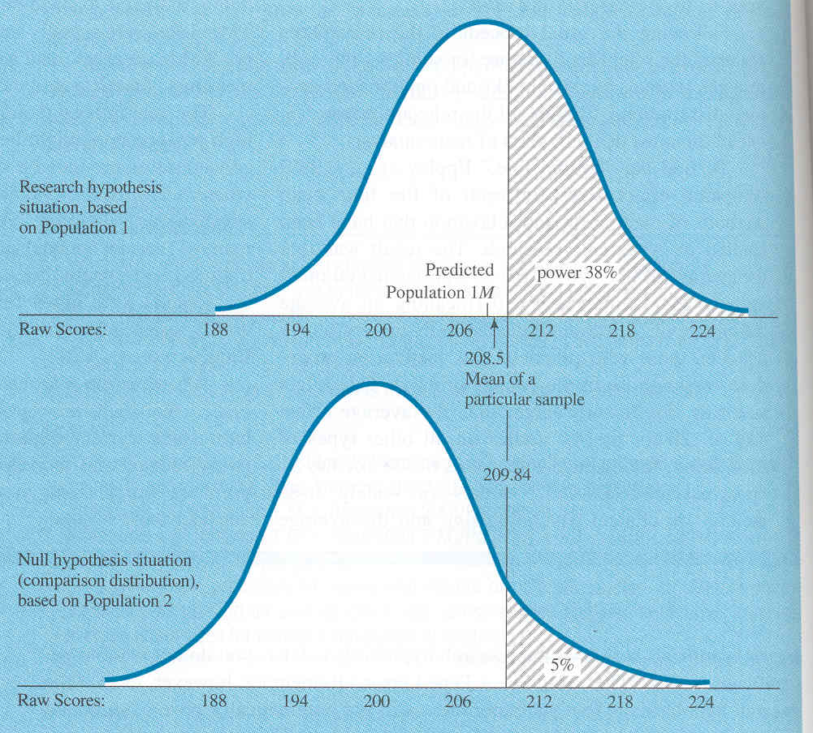
Statistical Power
Power = 38%
38% of
this distribution (shaded area)
falls in the
critical region (shaded area)
of the
comparison distribution.
So, we have a 38% chance of rejecting the null…
and a ( 100 – 38 = ) 62% chance of NOT rejecting the null.
The probability of Type II error is therefore fairly high.

Slide 33
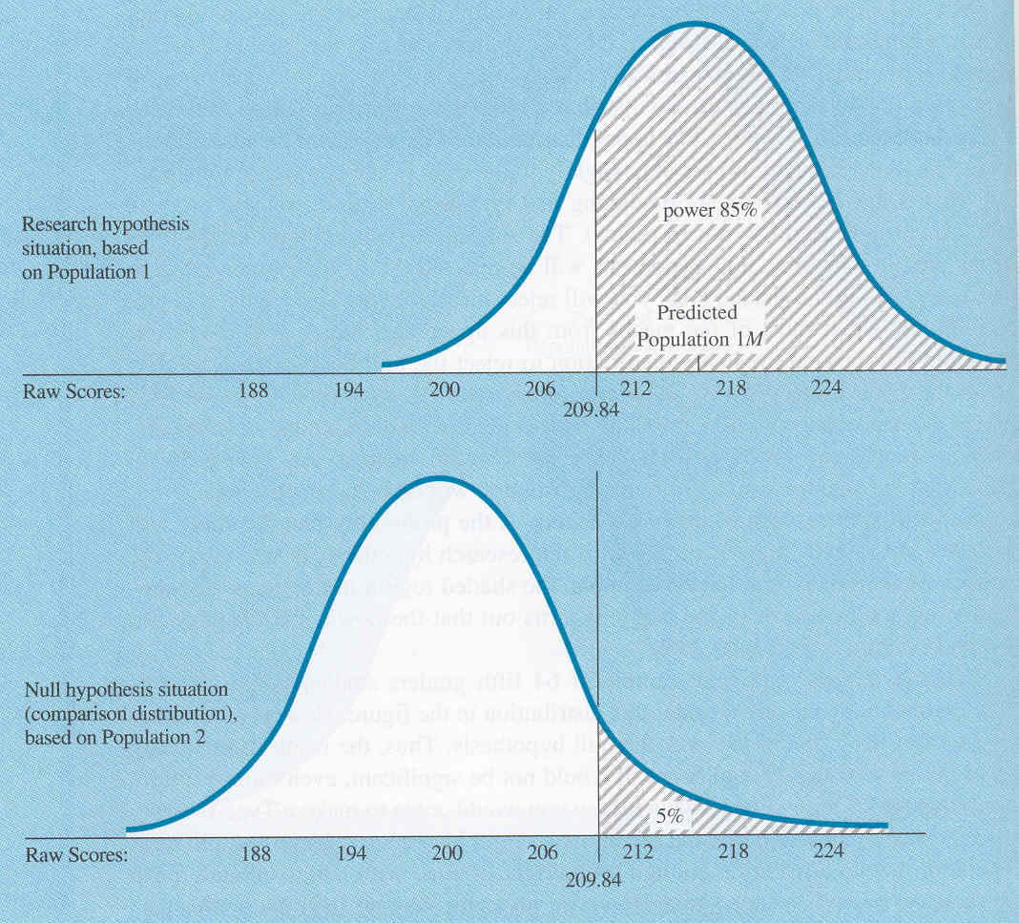
Statistical Power
Power = 85%
85% of
this distribution (shaded area)
falls in the
critical region (shaded area)
of the
comparison distribution.
So, we have a 85% chance of rejecting the null…
and a ( 100 – 85 = ) 15% chance of NOT rejecting the null.
The probability of Type II error is therefore fairly low.

Slide 34
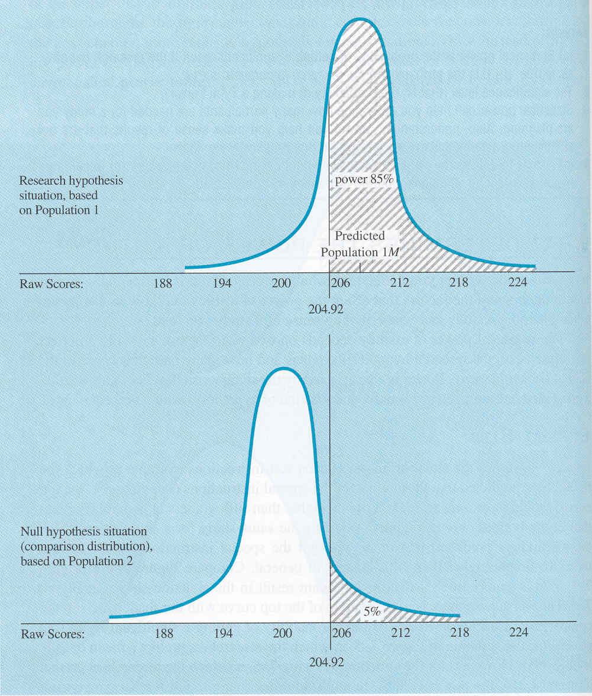
Statistical Power
Power = 85%
“Same story” as
previous slide…
but the SD is now
half what it was.

Slide 35
Statistical Power
Alpha = The probability of a Type I error
Beta = The probability of a Type II error
(sorry that there are so many “Beta’s” in science!)
Power = 1 – Beta
So, as Beta (probability of Type II error) grows, power decreases. Beta and Power are inversely related.

Slide 36
Statistical Power
Remember…conceptually… Power is the probability that a study will produce a statistically significant result if the research (“alternate”) hypothesis is true!
Let’s see the preceding slides again and now compute Beta…

Slide 37
Statistical Power
What does BETA
equal here?

Slide 38
Statistical Power
What does BETA
equal here?

Slide 39
Statistical Power
What does BETA
equal here?

Slide 40
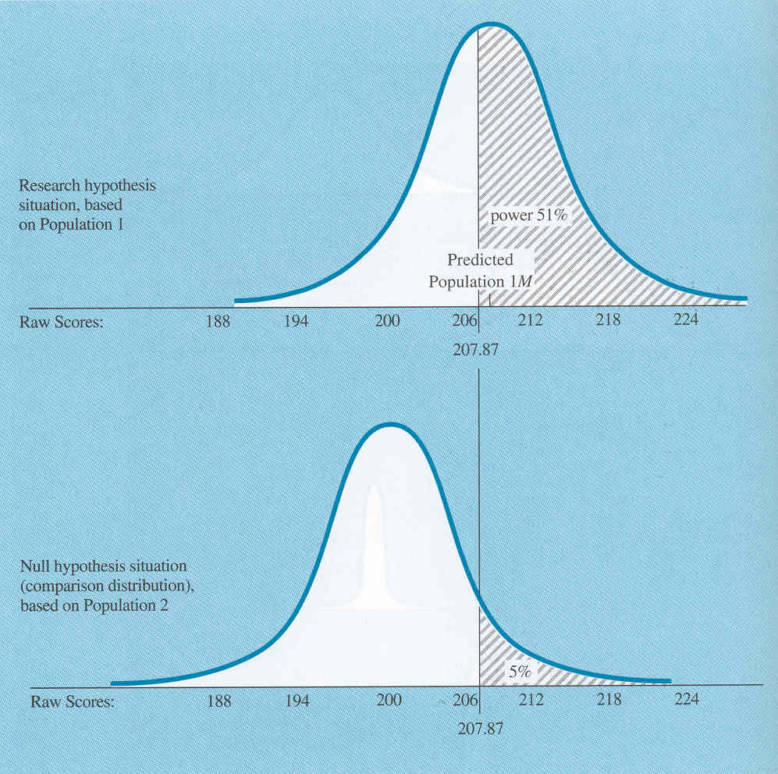
Statistical Power
What does BETA
equal here?

Slide 41
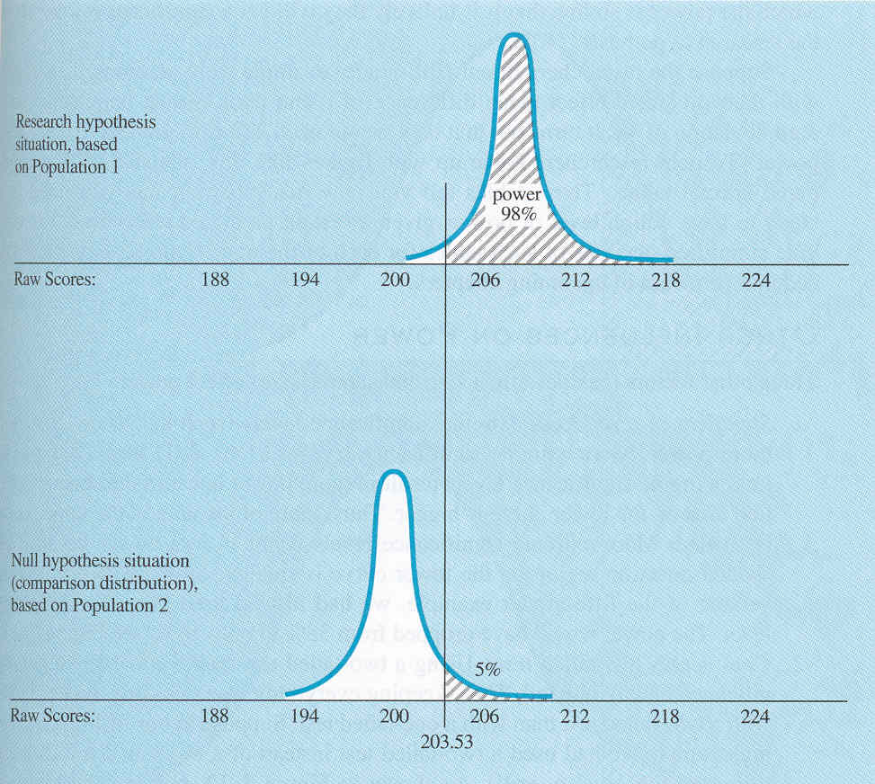
Statistical Power
What does BETA
equal here?

Slide 42
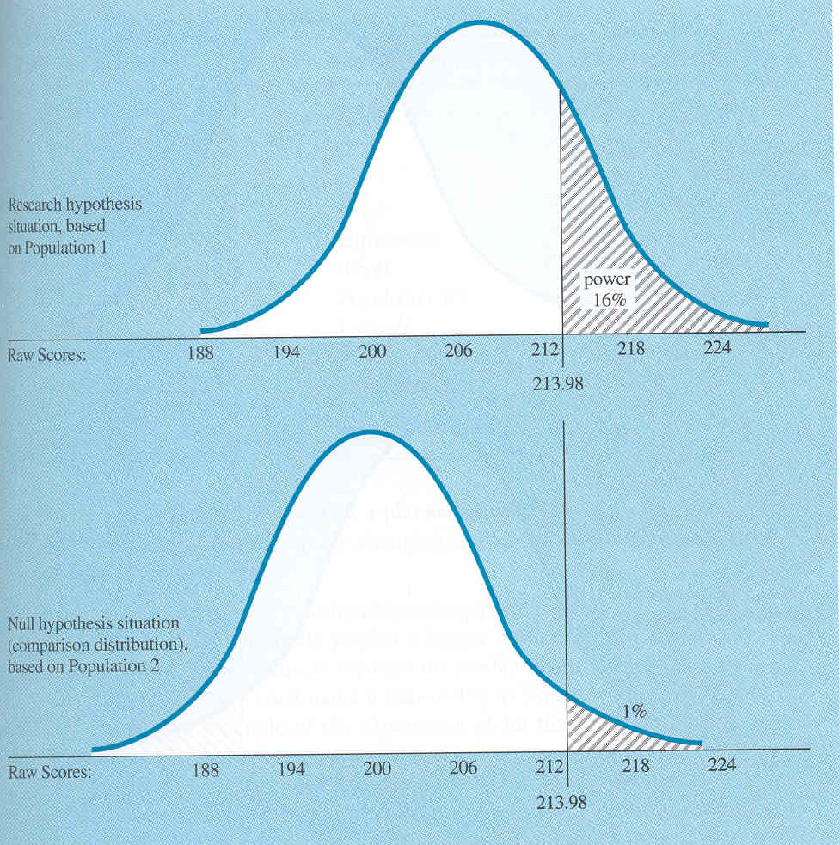
Statistical Power
What does BETA
equal here?

Slide 43
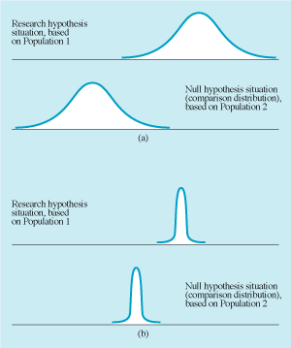
Statistical Power
Two distributions may have little overlap, and the study high power, because
The two means are very different
The variance is very small

Slide 44
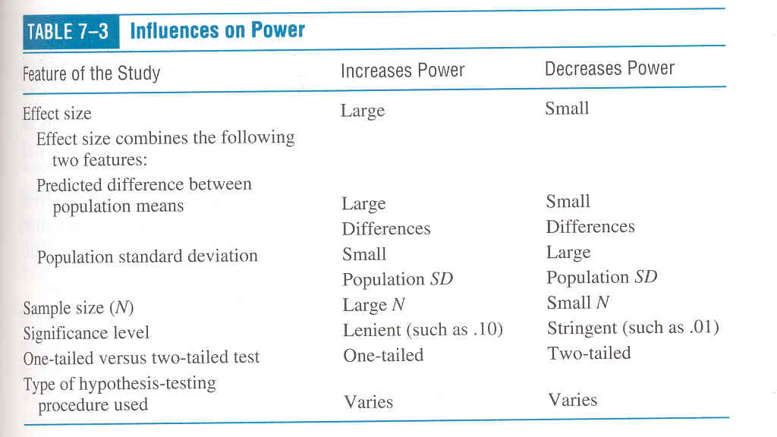
Statistical Power

Slide 45
Increasing Statistical Power
Generally acknowledged that a study should have at least 80% power to be worth undertaking
Power can be increased by…
Increasing mean difference
Use a more intense experimental procedure
Decreasing population SD
Use a population with little variation
Use standardized measures and conditions of testing
Using less stringent significance level
Using a one-tailed test instead of two-tailed
Using a more sensitive hypothesis-testing procedure

Slide 46
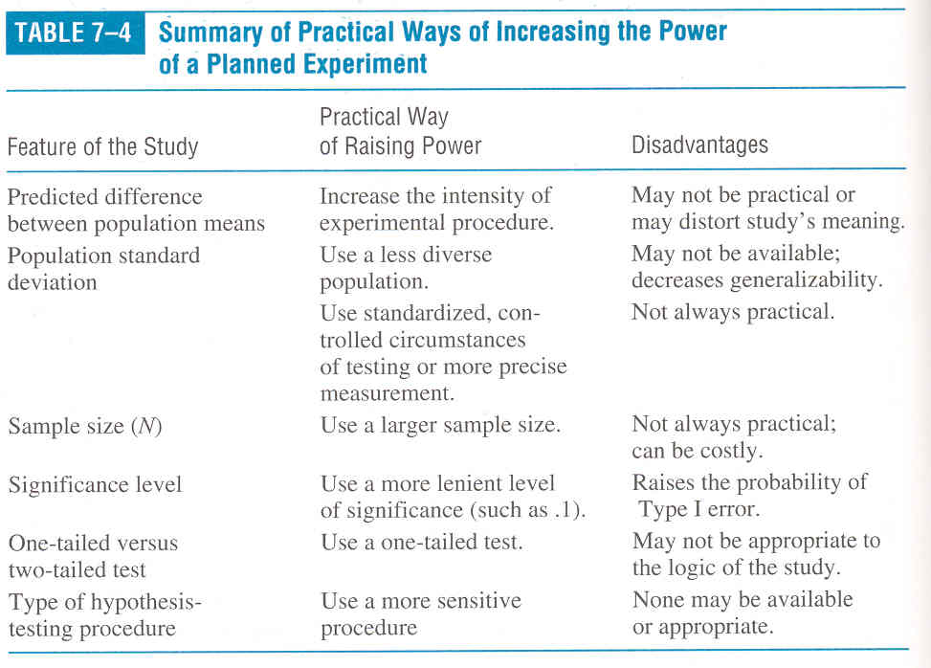
Statistical Power

Slide 47
Role of Power in Interpreting the Results of a Study
When result is significant
If sample size small, effect is probably practically significant as well
If sample size large, effect may be too small to be useful
When result is insignificant
If sample size small, study is inconclusive
If sample size large, research hypothesis probably false

Slide 48
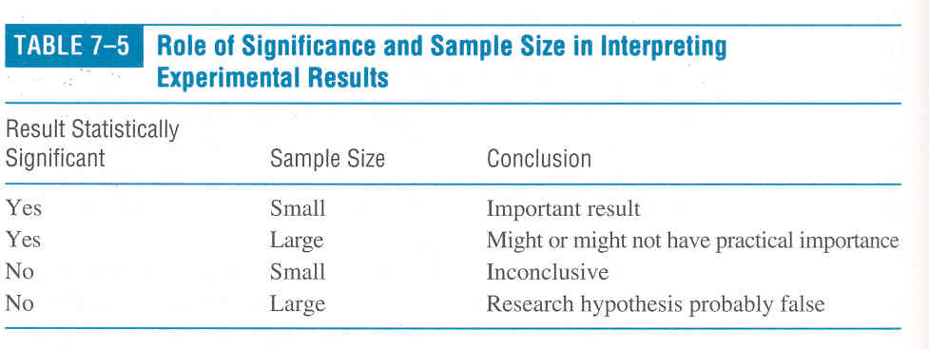
Statistical Power

Slide 49
Part 5
Some Intuitions About
Power & Sample Size

Slide 50
Intuitions About Power & Sample Size
An analogy that may help show the relationship among statistical power, and its constituents: Effect Size and Sample Size
Let’s go fishin’……

Slide 51
Intuitions About Power & Sample Size
Coarse Fishing Net
Fine Fishing Net
Small # of
“Nodes” (N)
Small N
Large # of
“Nodes” (N)
Large N

Slide 52
Intuitions About Power & Sample Size
Coarse Fishing Net
Fine Fishing Net
Only
Catches
Big
Fish
Can
Catch
Big or Small
Fish
Small # of
“Nodes” (N)
Small N
Large # of
“Nodes” (N)
Large N

Slide 53
Intuitions About Power & Sample Size
Coarse Fishing Net
Fine Fishing Net
Only
Catches
Big
Fish
Can
Catch
Big or Small
Fish
Analogy 1:
Fish Size = Effect Size
Big Fish = Big Effect
Small Fish = Small Effect
Small # of
“Nodes” (N)
Small N
Large # of
“Nodes” (N)
Large N

Slide 54
Intuitions About Power & Sample Size
Coarse Fishing Net
Fine Fishing Net
Only
Catches
Big
Fish
Can
Catch
Big or Small
Fish
Analogy 2:
# of Nodes = Sample Size
Few Nodes = Small Sample
Many Nodes = Large Sample
Small # of
“Nodes” (N)
Small N
Large # of
“Nodes” (N)
Large N

Slide 55
Intuitions About Power & Sample Size
If you go fishin’ and you get nothin’….
(A) Maybe the fish wasn’t there
OR
(B) Maybe you had the wrong kind of net for the fish you were fishin’ (too few nodes)

Slide 56
Intuitions About Power & Sample Size
If you go researchin’ and you get nothin’….
(A) Maybe the effect wasn’t there
OR
(B) Maybe you had the wrong sample size for the effect you were researchin’ (too few observations)

Slide 57
Role of Power in Interpreting the Results of a Study
When result is NON-significant
If sample size small (coarse fishing net, small n), study is inconclusive
If sample size large (fine fishing net, large n), research hypothesis probably false (there was no fish in the first place)

Slide 58
Role of Power in Interpreting the Results of a Study
When result is significant
If sample size small, effect is probably practically significant as well
If sample size large, effect may be too small to be useful
Remember, a result can be statistically significant,
and yet have no practical significance!
That is, there may be no important change in behavior!

Slide 59
Intuitions About Power & Sample Size
Critical Point:
Statistical Power is an important concept
because it helps us to interpret experimental results
(especially null findings) in a meaningful way!!!!!

Slide 60
Part 6
Using Power To Estimate
Sample Size

Slide 61
Formula For Estimating Sample Size
For a Correlational Study
2
δ
n =
+ 1
ranticipated

Slide 62
This is lower-case delta is derived from a Power Table.
Its value depends on your desired level of Power,
expressed as the probability of detecting a ‘true’
r-value of a specified size.
2
Required sample size.
δ
n =
+ 1
ranticipated
This anticipated value is for ‘r’, NOT r²
…but you might use Cohen’s r-squared classification system
to get an idea about what ‘small’, ‘medium’, and ‘large’
r² values would be –then convert r² to r.

Slide 63
Cohen’s Classification System
for r-squared values:
r² = 0. 01 “Small Relationship”
r² = 0.09 “Medium Relationship”
r² = 0.25 “Large”

Slide 64
Cohen’s Classifications
Note: Cohen is a well respected statistician who has made classification systems for different types of statistics.
The numbers he’s derived for one statistic (say the ‘r’ stat) differ from those of another statistic (say, an ANOVA, or a Chi-Square, or even “Cohen’s d”).

Slide 65
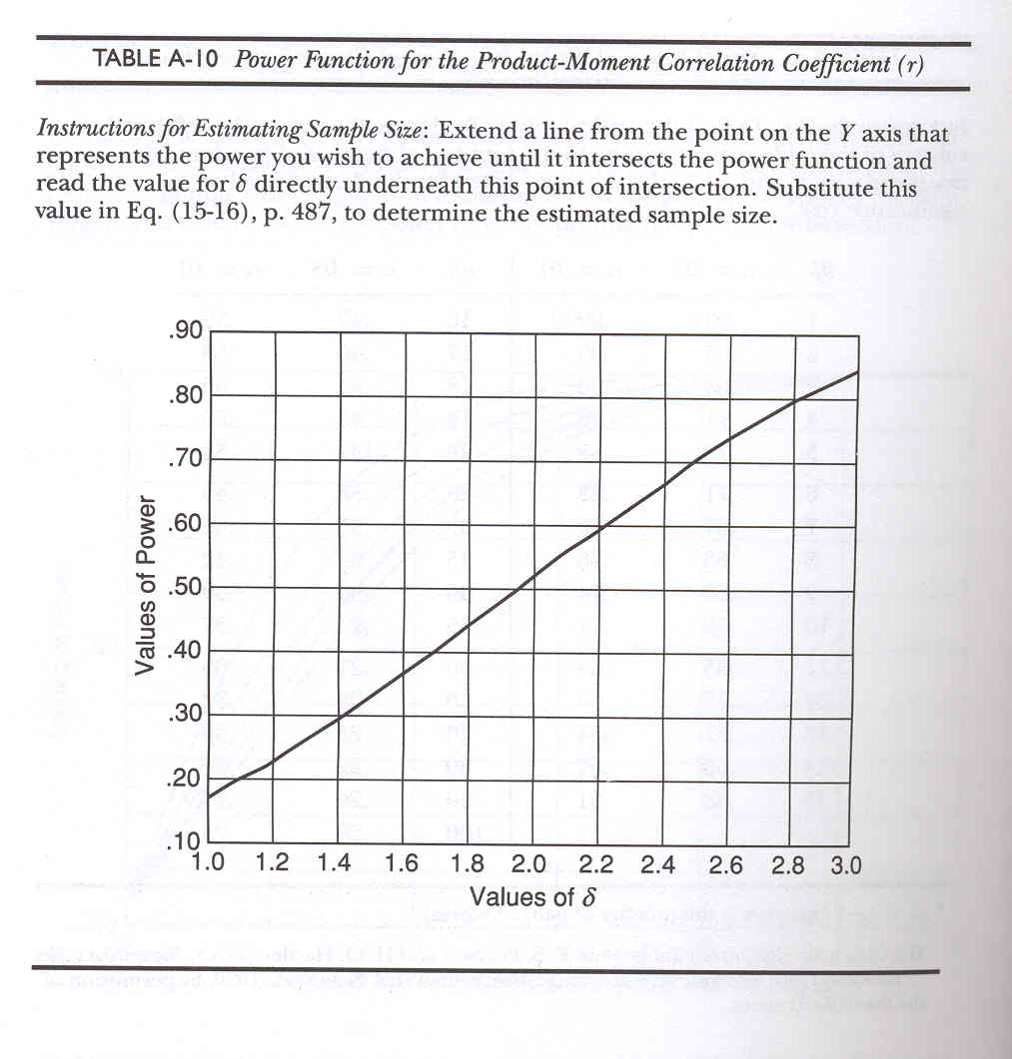

Slide 66
Benefits of Understanding Power
The ability to understand statistical power offers you (as a therapist and/or a basic researcher) two benefits….
First, knowing the statistical power in a study helps you to more meaningfully distinguish between statistical significance versus practical significance.
Second, knowledge about statistical power can help you to estimate your sample size. This will allow you a reasonable chance to find a given effect size…without wasting time and money resources. (Therapy and science are always subject to real-world constraints!)

Slide 67
Science without humanity?
Tisk, Tisk, Tisk!

